Slide 1

Data Science 101
Dr. Ann Hess, CSU Stat Lab

Slide 2
Outline
Graybill Statistics and Data Science Laboratory (aka the “Stat Lab”)
What is data science?
Common data science tasks
Data types and formatting
Software
Resources
Questions

Slide 3
Graybill Statistics and Data Science Laboratory
Expert statistical support for CSU researchers
Advice on study design, data analysis and statistical software
Support for grant proposals and funded projects
Stat Lab faculty/staff: Dr. Ann Hess and Dr. Eric Gilleland
statlab.colostate.edu

Slide 4
Stat Lab Consulting Support
Appointments with Faculty/Staff Consultants:
Support relating to research proposals, study design, more complicated analyses and manuscript preparation
Drop in with Data:
Guidance with data formatting, data “wrangling”, data visualization and common statistical analyses
No appointment necessary

Slide 5
Stat Lab Funding
There is no charge for general consulting for graduate students (or vet residents) and for initial faculty meetings.
This service is supported by the Statistics department, Ag Experiment Station, CNS and CVMBS.
We rely on support from individual faculty users. Even small contributions are very welcome!
Support requested for grant funded projects.
Fee-for-service data analysis is available for projects that go beyond general consulting.

Slide 6
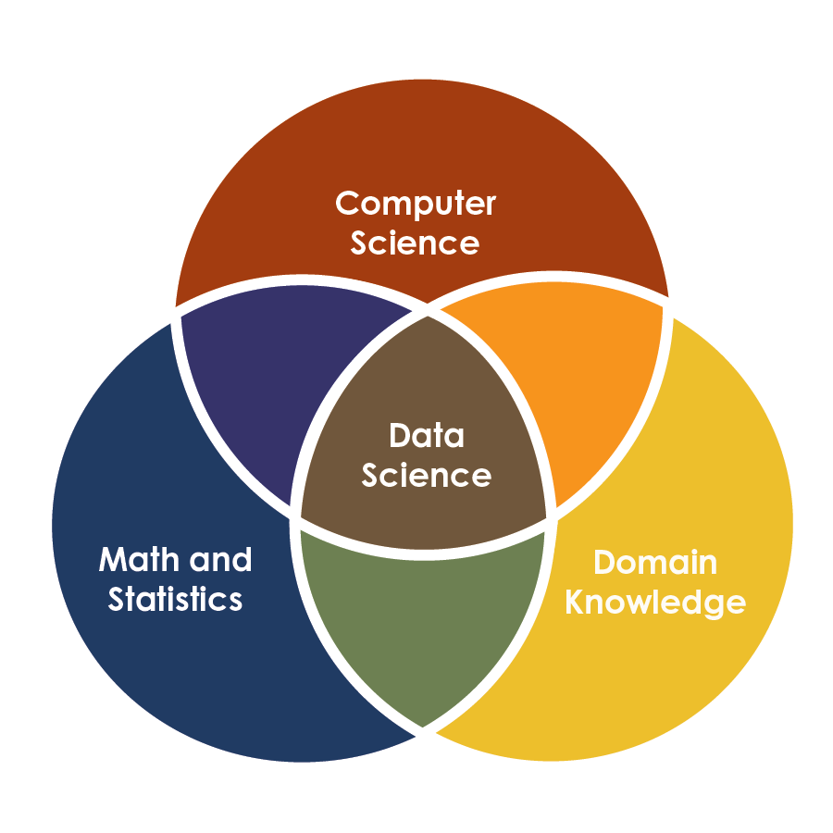
What is data science?
Process of learning from data, in order to make informed decisions
Gathering data
Organizing and studying information
Finding patterns
Using results to address questions
https://www.datascience-pm.com/data-science-vs-software-engineering/

Slide 7
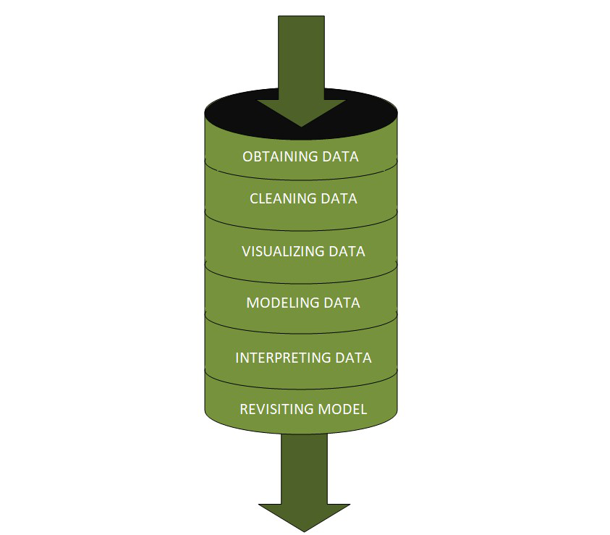
Data Science Process
Start with a question!
Collect data
Clean and organize
Explore and visualize
Build models
Communicate results
https://www.analyticsvidhya.com/blog/2022/08/basic-introduction-to-data-science-pipeline/

Slide 8
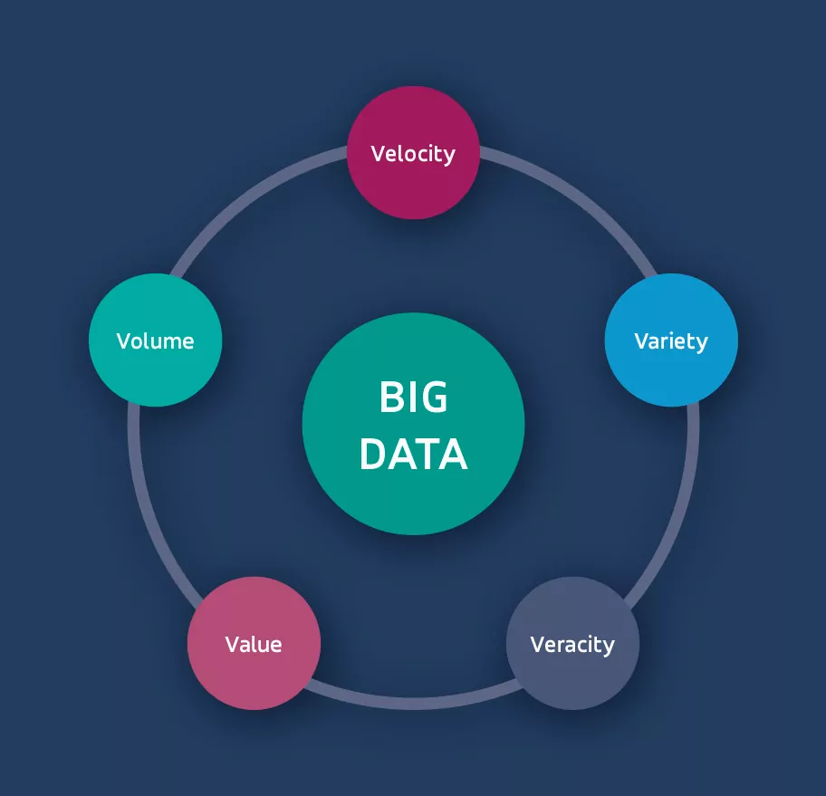
Big Data
Extremely large datasets that cannot be easily stored, managed, or analyzed using traditional methods
More common at CSU
big p > little n:
  Predictors (p), features, columns
  Observations (n), units, rows
https://neurosys.com/blog/big-data-tools

Slide 9
Common Data Science Tasks
Specific tasks depend on the project!
We do data science to address research questions.

Slide 10
Data Cleaning, Wrangling and Preprocessing
“Data science is 80% preparing data, 20% complaining about preparing data.”
Richard Cornelius Suwandi
Cleaning
Handling missing values
Identifying and handling typos and outliers
Removing duplicates
Wrangling
Merging
Reshaping (long ↔ wide)
Aggregation
Preprocessing
Variable calculation, transformation, scaling
Technology specific steps
Filtering

Slide 11
Visualization
Good visualizations will tell the story of the data.
Simple, uncluttered graphs make it easier for readers to absorb information.
Often show both trends/associations AND exceptions.
“The numbers have no way of speaking for themselves. We speak for them. We imbue them with meaning.” Nate Silver
“The greatest value of a picture is when it forces us to notice what we never expected to see.” John Tukey

Slide 12
Predictive Modeling (Supervised Learning)
Goal: predict a response using predictors (features).
MANY methods available: regression, random forest, lasso, xgboost
Some methods select a subset of predictors.
Other methods use all predictors, but provide measures of “variable importance”.
Evaluate predictive performance using training/test split OR cross validation.

Slide 13
Clustering (Unsupervised Learning)
Goal: group similar data points together, without using labels.
MANY methods available: k-means, hierarchical, dbscan
Clustering results are presented graphically

Slide 14
Weather Example: Desroisers & Bell (2024)
Desroisers & Bell (2024). Airborne Radar Quality Control with Machine Learning. Artificial Intelligence for the Earth Systems 3.1 (2024): e230064.
Abstract: “Airborne Doppler radar provides detailed and targeted observations of winds and precipitation in weather systems over remote or difficult-to-access regions that can help to improve scientific understanding and weather forecasts. Quality control (QC) is necessary to remove nonweather echoes from raw radar data for subsequent analysis. The complex decision-making ability of the machine learning random-forest technique is employed to create a generalized QC method for airborne radar data in convective weather systems. A manually QCed dataset was used to train the model….”

Slide 15
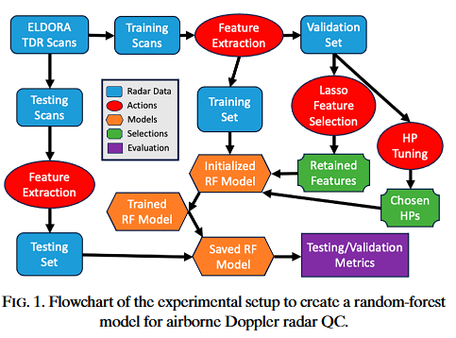
Weather Example: Data
Response variable: Weather, binary (yes/no)
Predictor variables (features): p =14 numeric variables
n = 87.9 million total radar gates
Split into training (72%), validation (8%), and testing (20%) sets

Slide 16
Weather Example: Analysis and Results
Software: Python?
Predictive models using random forest (RF) and lasso logistic regression to predict weather (binary)
Results:
  Feature importance (RF) or feature selection (lasso)
  Precision (or positive predictive value)
  Recall (or true positive rate or sensitivity)

Slide 17
Decomposition Example: Metcalf et al (2016)
Metcalf et al (2016). Microbial community assembly and metabolic function during mammalian corpse decomposition. Science, 351(6269), 158-162.
Abstract: “Vertebrate corpse decomposition provides an important stage in nutrient cycling in most terrestrial habitats, yet microbially mediated processes are poorly understood. Here we combine deep microbial community characterization, community-level metabolic reconstruction, and soil biogeochemical assessment to understand the principles governing microbial community assembly during decomposition of mouse and human corpses on different soil substrates. We find a suite of bacterial and fungal groups that contribute to nitrogen cycling and a reproducible network of decomposers that emerge on predictable time scales.

Slide 18
Decomposition Example: Data
Response variable: post mortem interval (PMI), numeric
Predictor variables (features): microbial taxa (p = hundreds or thousands?)
n = 15 mice, with multiple locations per mouse

Slide 19
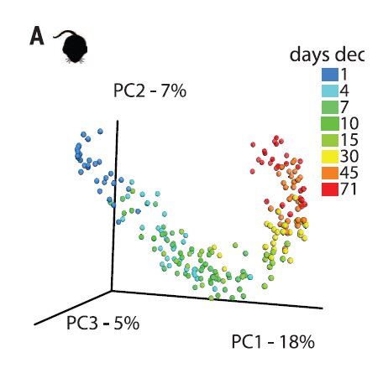
Decomposition Example: Analysis and Results
Software: Qiime (microbiome analysis) and R
Principle Coordinates Analysis (using distances)
Random Forest (RF) to predict PMI (#)
Results: Accuracy of RF model measured as root mean squared error (RMSE)

Slide 20


Data Types
Data type is a simple idea that is very important for guiding appropriate analysis.
Categorical (Qualitative) variables: values represent categories or groups.
  Examples: weather (yes/no), animal species, transport type
  Even if numbers are used for coding, these are just (arbitrary) labels
Numeric (Quantitative) variables: represent amounts or quantities
  Examples: PMI, tree canopy cover, air temperature

Slide 21
Why is data type so important?
Summarization/Visualization:
  For categorical variables, use counts, proportions or percentages.
  For numeric variables, use mean, median, mode, etc.
Modeling:
  For categorical responses, “classification” via logistic regression (and related methods)
  For numeric responses, “regression” via linear regression (and related methods)
Predictive performance:
  For categorical responses, use accuracy, precision, recall, etc
  For numeric responses, use root mean squared error.

Slide 22
Data Formatting
Data formatting is a critical step for analysis.
The original data should never be modified and should be stored in a secure location!
Common to have multiple versions of the data. Plan ahead to reduce the number of versions.
Keep track of the steps you take in your clean up and analysis (just as you would keep track of any other research step).

Slide 23
Data Formatting: Make it a Rectangle
Single (big) rectangle with:
  rows contain observations (often subjects or other units)
  columns contain variables
  cells contain values
Variable/Column names:
  First row (only)
  Short, unique, informative variable names

Slide 24
Data Formatting: Variables/Columns
Only one variable per column (e.g., separate date and age)
  Do not merge cells
Be consistent!
  Consistent data type: a column should contain categorical OR numeric values.
  Consistent codes for categorical variables.
  Consistent code (or blank) for any missing values.

Slide 25
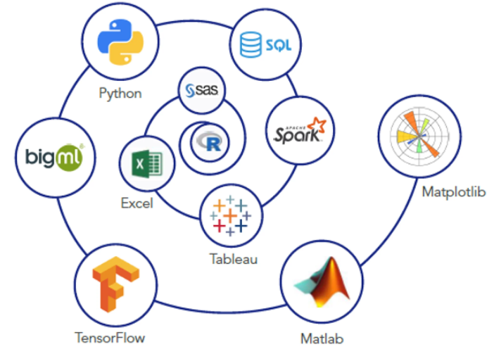
Software for Data Science
Programming Languages
  Python (Pandas, Scikit-learn packages)
  R (tidyverse, caret packages)
  SQL: relational databases
Non-programming Options
  Tableau: data visualization
  PowerBI: data visualization
  Excel
  JMP: statistical software
https://introtallent.com/data-science-tools/

Slide 26
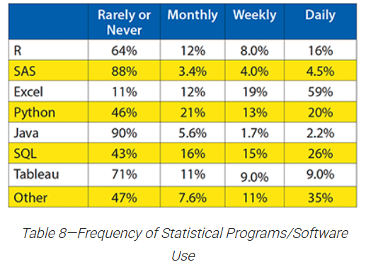
2024 ASA survey of recent Statistics BS graduates
Most frequently used software
  Excel, SQL, Python
From the “other” category:
  PowerBI, C++, AWS
https://magazine.amstat.org/blog/2024/12/02/bachelors/

Slide 27
Benefits of Coding
Automate repetitive tasks: save time and reduce errors
Flexible analysis: access a wide variety of (free) tools
Improve reproducibility: check, update and share your work
The hardest part is beginning!
AI is making coding easier.

Slide 28
Coding Basics
Objects: store data
Functions: perform actions
Arguments: provide information to functions
Packages: bundles of functions, data and documentation that extend core functionality.

Slide 29
A very simple example: objects vs functions
R software
# Create a vector
numbers <- c(1, 2, 3, 4, 5)
# Calculate the mean
value <- mean(numbers)
# Show result
value
Python software
import statistics
# Create a list
numbers = [1, 2, 3, 4, 5]
# Calculate the mean
value = statistics.mean(numbers)
# Show result
print(value)

Slide 30
JMP is a non-coding alternative
Free to download for academic users
Predictive Modeling: random forest, lasso and neural nets available
Clustering: k-means, hierarchical, normal mixtures available
Graph builder: interactive tool

Slide 31
CSU Resources
CSU Stat Lab
Coding and Cookies workshops (R, Python, Git) collaboration between Stat Lab and Libraries
Coding Support Hub from the CSU Libraries
Data Science Research Institute
Research Computing and Cyberinfrastructure including high performance computing (HPC) from CSU OVPR

Slide 32
External Resources
https://towardsdatascience.com/
Coursera Free Data Science Courses
YouTube Channels

Slide 33
Questions?

